Slide 1

DEPARTMENT OF COMPUTER SCIENCE & ENGINEERING
Title: Title of the Project
BATCH ID : 23MPCS-F5
S. No | Roll. No | Student Name
1 | 23881A05AW | M. Srikar Reddy
2 | 23881A05BJ | R. Shrija
3 | 23881A05BN | S. Sri Harsha
Guide Details
Ms. Kolarkar Ashlesha Vijay
Assistant Professor
Department of CSE

Slide 2
Mini Project Review-2 Outlines
Main idea of the Project
Existing System Vs Proposed
Proposed Project Objectives
Proposed Project Outcomes
Software and Hardware Requirements
Process Model
Design Phase
Architectural Diagram [Modified]
[UML Diagrams or Data Flow Diagrams] and ER-Diagrams ; It should be detailed diagrams
Proposed Methods and Algorithms
Results
Conclusion

Slide 3
Main idea of the Project
EduAssist is an AI-based smart conversational chatbot designed to assist students with college enquiries.
It provides instant responses to common questions related to admissions, courses, fee structure, scholarships, and campus facilities.
The chatbot uses Artificial Intelligence (AI) and Natural Language Processing (NLP) to understand user queries and respond in a conversational manner. The system helps reduce the workload of college administrative staff by automatically handling frequently asked questions.
Overall, the project aims to improve communication between students and the institution through an automated and user-friendly enquiry system.

Slide 4
Existing System Vs Proposed
Existing System
Manual enquiry through phone, email, or college office.
Available only during office hours.
Slow response and higher staff workload.
Proposed System (EduAssist)
AI chatbot answers academic queries automatically.
Generates study plan.
Fast responses and reduced administrative work.
AI adaptive quizzes
DEPARTMENT OF CSE MINI PROJECT REVIEW-4

Slide 5
Proposed Project Objectives
To develop an AI-based chatbot that can answer college enquiry questions automatically.
To provide quick and accurate information about admissions, courses, fees, and campus facilities.
To create a 24/7 virtual assistant for students and parents.
To reduce the workload of college administrative staff by handling frequently asked questions.
To improve communication and accessibility of information through a user-friendly conversational interface.

Slide 6
Proposed Project Outcomes
Students receive instant answers to college enquiry questions.
The system provides accurate information about admissions, courses, and fees.
24/7 availability of enquiry support for students and parents.
Reduced workload for college administrative staff.
Improved communication and user experience through an AI-based chatbot.

Slide 7
Software and Hardware Requirements
Software Requirements
Operating System: Windows / macOS / Linux
Programming Language: Python
Development Tools: VS Code / PyCharm
Frameworks/Libraries: NLP libraries (NLTK / TensorFlow / Flask)
Database: MySQL / SQLite
Web Technologies: HTML, CSS, JavaScript
Hardware Requirements
Processor: Intel i3 or higher
RAM: Minimum 4 GB
Storage: 100 GB Hard Disk or SSD
Internet Connection for chatbot access and updates

Slide 8
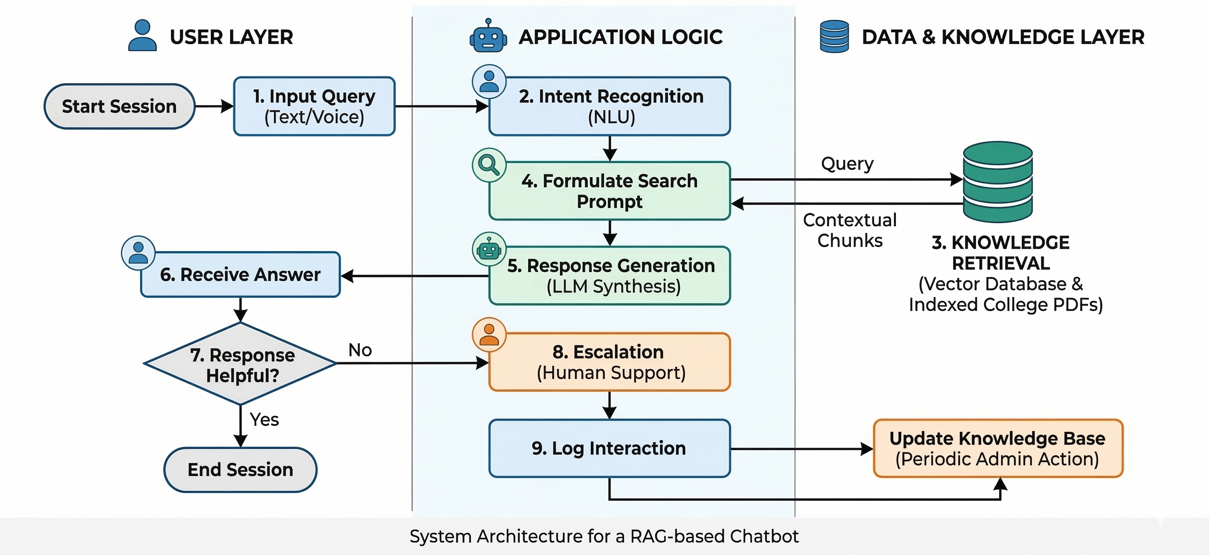
Process Model

Slide 9
Architectural Diagram
Student
(Web/Mobile User)
Frontend
HTML, CSS, JS UI
Chat + Study Plan
API Request
Backend
Flask Server
Chatbot Logic
Study Planner
AI Processing
(OpenAI / Algorithm)
Response Sent
Study Plan / Chat

Slide 10
PROPOSED METHOD AND ALGORITHMS
Collect common college enquiry questions (admissions, courses, fees, etc.).
Store the information in a knowledge base or database.
Use Natural Language Processing (NLP) to understand user queries.
Process the query and match it with the most relevant response.
Display the answer to the user through a chatbot interface on the website.

Slide 11
PROPOSED METHOD AND ALGORITHMS
Natural Language Processing (NLP) – To understand and process user input.
Intent Recognition Algorithm – To identify the purpose of the user’s question.
Text Preprocessing (Tokenization & Keyword Extraction) – To analyze the query.
Response Matching Algorithm – To find the most relevant answer from the database.

Slide 12
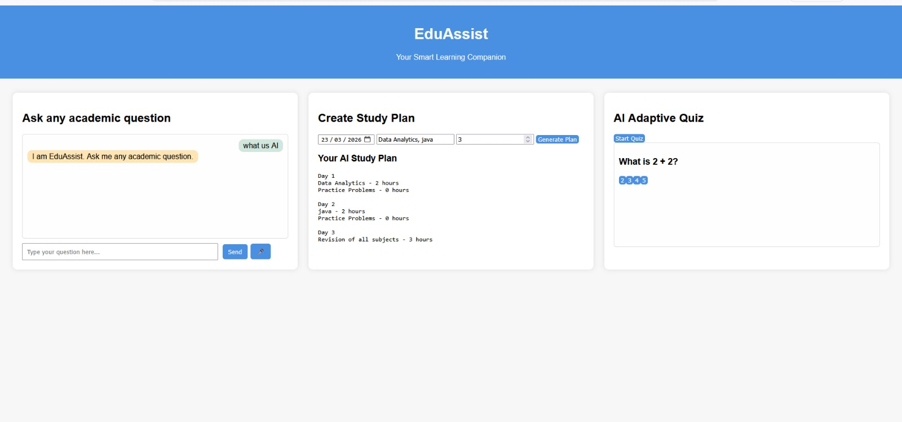
Results

Slide 13
Conclusion
The EduAssist chatbot provides a smart and efficient solution for handling college enquiries. It uses AI and NLP techniques to understand user queries and provide instant responses about admissions, courses, and other college information. The system improves communication between students and the institution while reducing the workload of administrative staff. Overall, the chatbot offers a fast, reliable, and user-friendly platform for accessing college-related information anytime.

Slide 14
Thank You

